Slide 1
Measuring Parallax

Slide 2
Definition of Parallax
Parallax is the apparent displacement of an object against the background when seen from two different perspectives.

Slide 3
How to Measure Stellar Parallax
To measure the distance to a star, astronomers measure the parallax shift of the star using 2 points of view that are as far apart as possible-at opposite sides of Earth’s orbit.

Slide 4
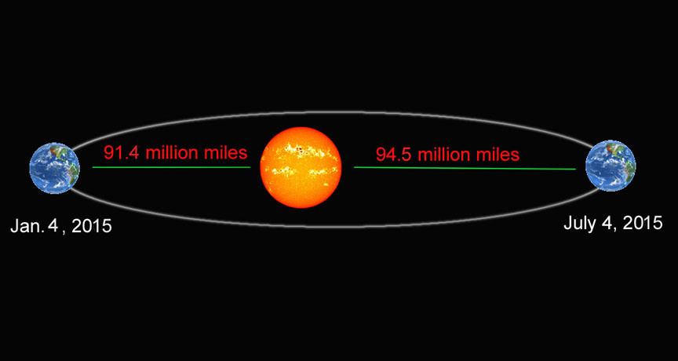

Slide 5
The direction from Earth to a nearby star changes as our planet orbits the Sun and the nearby star appears to move back and forth against the background of more distant stars.

Slide 6
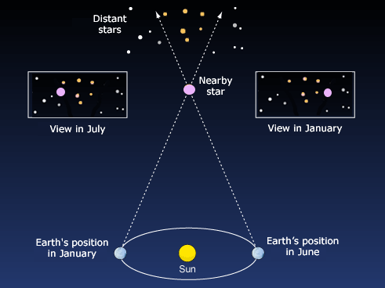

Slide 7
Stellar Parallax
The parallax (p) of a star is equal to half the angle through which the star’s apparent position shifts as Earth moves from one side of its orbit to the other. The larger the parallax (p) the smaller the distance (d) to the star.

Slide 8
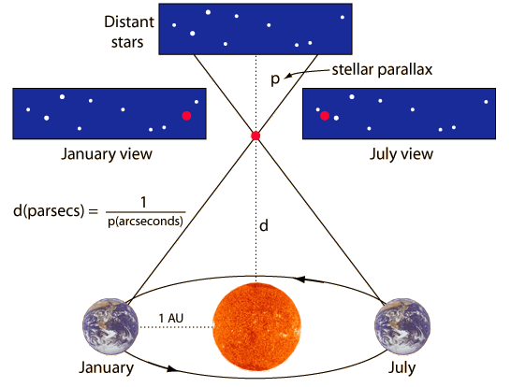

Slide 9
How do we change this apparent shift into a distance measurement?
Parallax Formula
Visualizing Parallax

Slide 10
This simple relationship between parallax and distance reveals that the closest stars have the greatest parallax.

Slide 12
Baseline
In parallax there is always a “baseline” distance that we know. Astronomers use the distance from one side of Earth’s orbit to the other to measure stellar parallax.

Slide 13
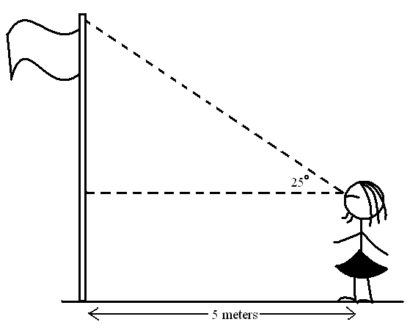
Using Parallax Angles
Measuring stellar parallax
Measuring the height of a flagpole

Slide 14
Limitations of Parallax
Can only be used to judge the distance to the nearest stars
For extremely distant stars, even having two viewpoints separated by 186 million miles is not enough to make a star appear to jump from side to side.

