Slide 1
PROPERTIES OF LIGHT
A little review

Slide 2
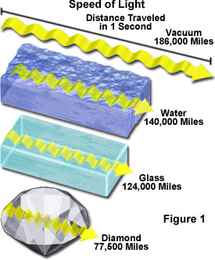
Speed of Light
Light travels through empty space at a speed of 299,792.458 km/s or 186,282.397 mi/s
The speed decreases when light travels through a transparent material

Slide 3
Speed of Light
Galileo: Determined that the speed of light is too fast to be measured by human reactions
Rømer: Timed eclipses of Jupiter’s moons and realized that the speed of light was finite
Maxwell: Revealed that light of all wavelengths travels at the same speed in a vacuum

Slide 4
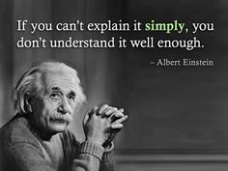
Speed of Light
Einstein: Developed theory of relativity: nothing can travel faster than the speed of light

Slide 5
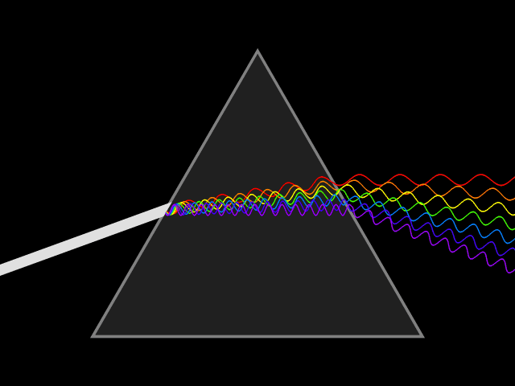
Sunlight is a mixture of all colors
Determined by observing light as it passes through other mediums such as a glass prism

Slide 6
Isaac Newton
Wanted to prove that the prism separated the colors rather than added colors to the light

Slide 7
Is light a particle or a wave?
http://ed.ted.com/lessons/is-light-a-particle-or-a-wave-colm-kelleher

Slide 8
Behavior of Light

Slide 9
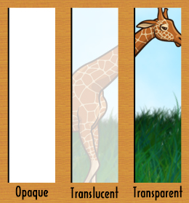
In order for you to see an object it must reflect some light
The type of matter in an object determin3s the amount of light it absorbs and reflects

Slide 10
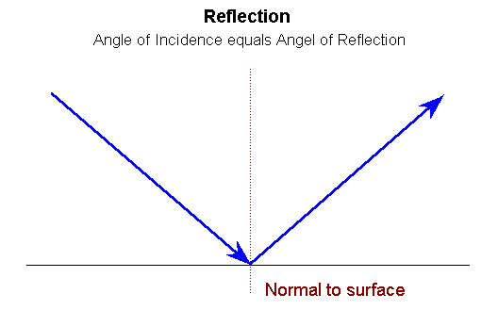
Law of Reflection
Reflection occurs when a wave strikes an object and bounces off

Slide 11
Refraction
Refraction is the bending of waves caused by a change in their speed when they move from one medium to another
The greater the difference between the speeds of light in two media the more the light is bent

Slide 13
Light is measured in wavelengths

Slide 14
Light can also be described in terms of frequency
Shorter wavelength higher frequency
Frequency is measured in Hz , # of wave crests that pass a given point in 1 second

Slide 15
Similarities in electromagnetic radiation
Various types share many basic properties:
All photons
All travel at the same speed
All sometimes behave as particles and sometimes as waves

Slide 16
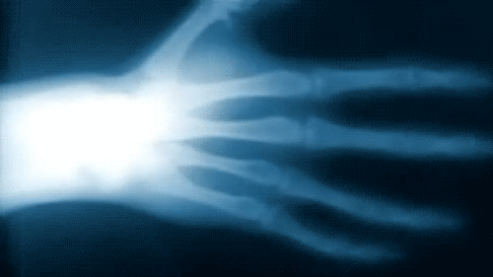
Differences in electromagnetic radiation
Different wavelengths, different energies
React differently with matter
X-rays have high energy and short wavelengths. X-rays are usually referred to in terms of energy rather than wavelength because their wavelength is so short

Slide 17
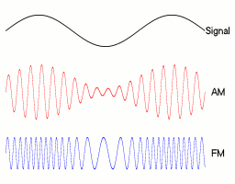
Radio waves
Radio detects radio waves but not ultraviolet radiation
AM stands for Amplitude
Modulation and FM stands for
Frequency Modulation

Slide 18
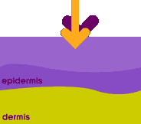
Ultraviolet radiation
Ozone depletion decreases our protection from UV radiation

Slide 19
Visible light can be seen and is separated into colors

Slide 20
Color
Green grass appears green to our eyes because when struck by white light all light except green is absorbed and the green is reflected
Objects that appear black absorb all colors of light and reflect little or no light back to the eye

Slide 22
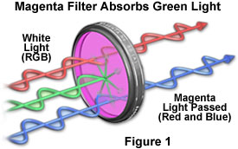
Light Filters
A light filter is a transparent material that transmits one or more colors of light but absorbs all others.
The color of a filter is the same as the color of light it transmits

Slide 23
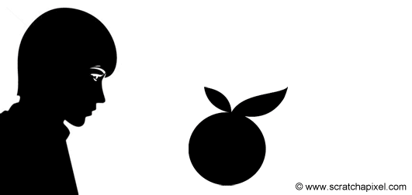
An object appears white when it reflects all wavelengths and black when it absorbs all wavelengths. Other objects appear in colors dependent on which wavelengths are absorbed and which are reflected.

Slide 24
Vision
Vision begins when light enters the eye and the cornea and lens focus it onto the retina, a thin layer of tissue at the back of the eye that contains millions of light-sensitive cells called photoreceptors. Some photoreceptors are shaped like rods and some are shaped like cones.

Slide 25
Anatomy of the Human Eye

Slide 26
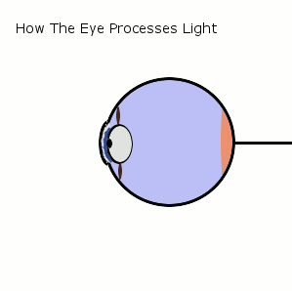

Slide 27
Many more rods than cones
Both contain photopigment molecules that undergo a chemical change when they absorb light.
Chemical change acts like an on-switch, triggering electrical signals that are then passed from the retina to the visual parts of the brain.

Slide 28
Rods and cones are different in how they respond to light. Rods are more responsive to dim light, which makes them useful for night vision. Cones are more responsive to bright light, such as in the daytime when light is plentiful.

Slide 29
Photopigments
All rods contain only one photopigment
Cones contain one of three different photopigments
Cones sensitive to long (red), medium (green), or short (blue) wavelengths of light.
Presence of three types of photopigments, each sensitive to a different part of the visual spectrum, is what gives us our rich color vision.

Slide 30
Trichromatic vision
Humans are unusual among mammals for our trichromatic vision – named for the three different types of photopigments we have.
Most mammals have just two photopigment types.
Other creatures, such as butterflies, have more than three. They may be able to see colors we can only imagine.

Slide 31
Most of us have a full set of the three different cone photopigments and so we share a very similar color vision experience
In the case of color blindness, your red and green may be someone else’s brown.

Slide 32
Red-green colorblindness
red cone photopigment is abnormal, red, orange and yellow appear greener and colors are not as bright, mild, X-linked
no working red cones, red appears black, certain shades of orange, yellow and green all appear as yellow
green cone photopigment is abnormal, yellow and green appear redder and it is difficult to tell violet from blue, mild, X-linked

Slide 33
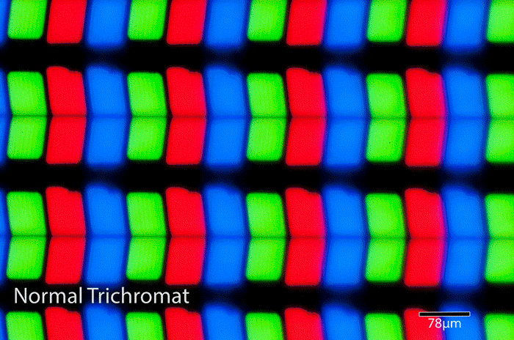
Red-green colorblindness continued
No working green cone cells, tend to see reds as brownish yellow and green as beige, X-linked

Slide 34
Blue-yellow colorblindness
Limited blue cone cells, blue appears greener and it can be difficult to tell yellow and red from pink, very rare, autosomal dominant
Lack blue cone cells, blue appears green and yellow appears violet or light gray, extremely rare autosomal recessive

Slide 35
Complete colorblindness
Failure of 2 of 3 cone cell pigments to work, rare, have trouble distinguishing colors, autosomal recessive
none of the cone cells have functional photopigments, see the world in black, white and gray, rare, present at birth, autosomal recessive

