Slide 1
Astronomy Kit design

Slide 2
Topics
The Movement of the Celestial Sphere
Seasons
Phases of the Moon
Lunar Eclipse
Solar Eclipse

Slide 3
Roles for the group members
Scientific Consultant: Creates the insert which explains the science (graphics included)
Technical Writer: Writes the directions for kit assembly (with a well labeled diagram)
Graphic Designer: Designs box containing the kit(marketing ad included)
Project Engineers: Create the model

Slide 4
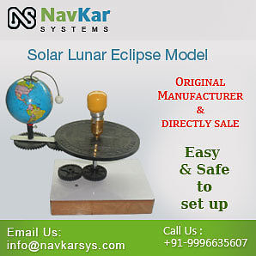
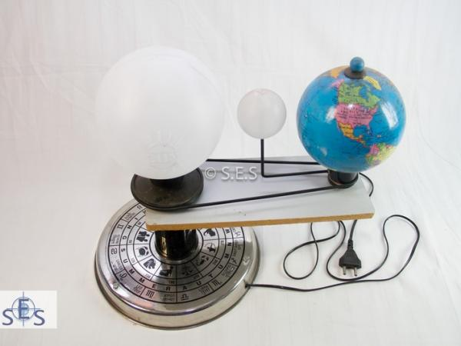

Slide 5
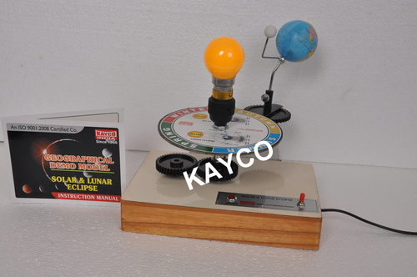
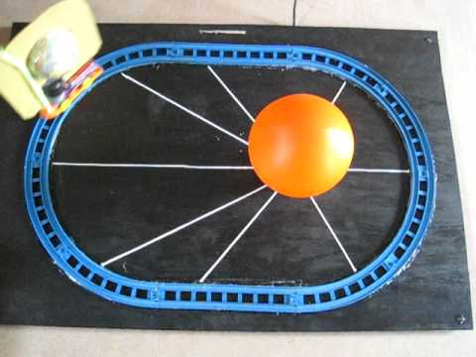

Slide 6
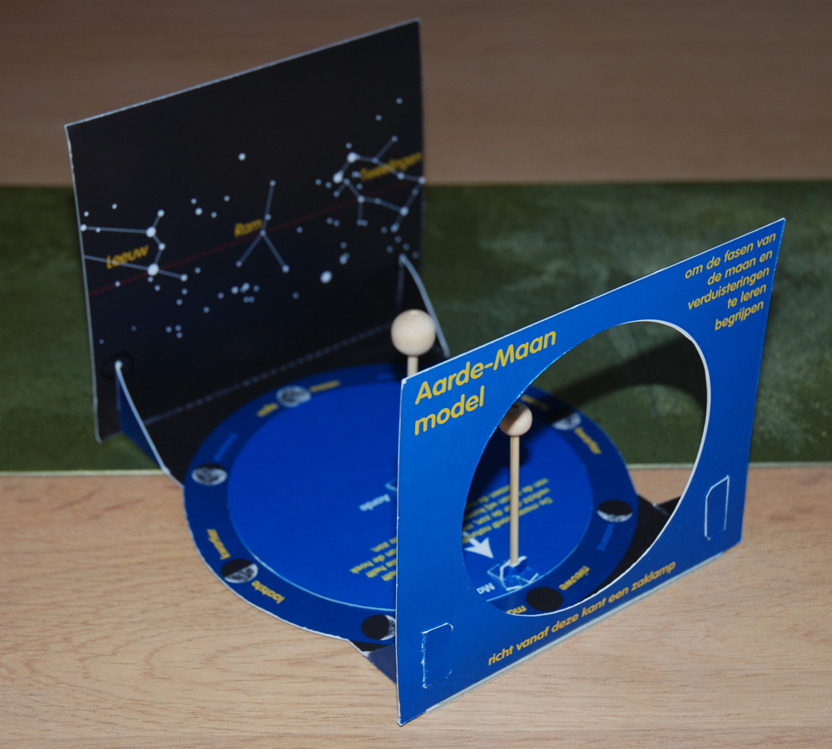
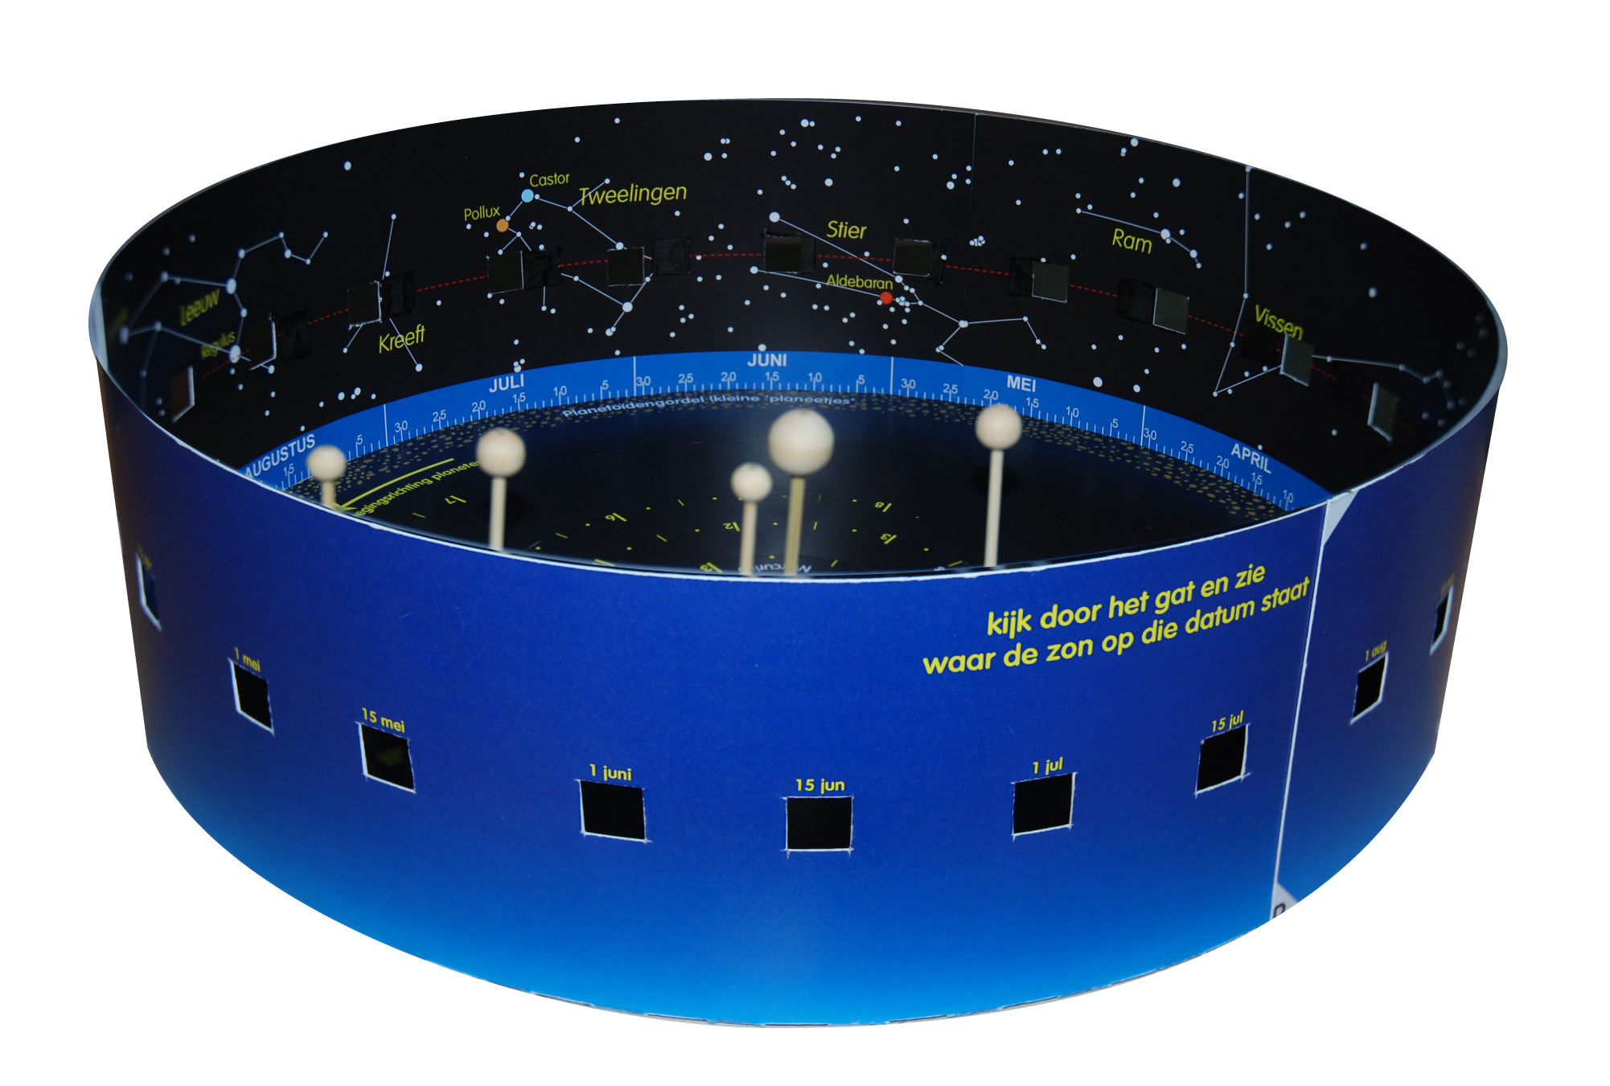

Slide 7
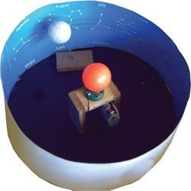
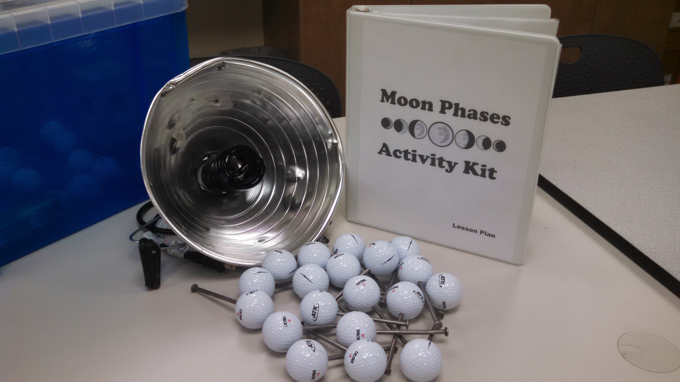

Slide 8
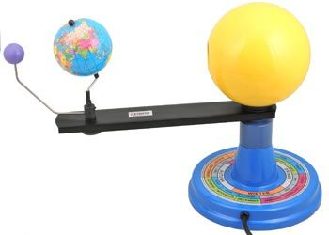
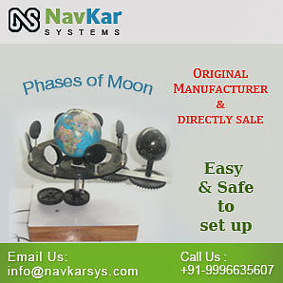

Slide 9
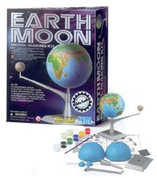
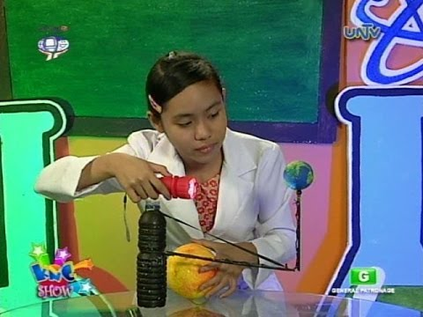

Slide 10
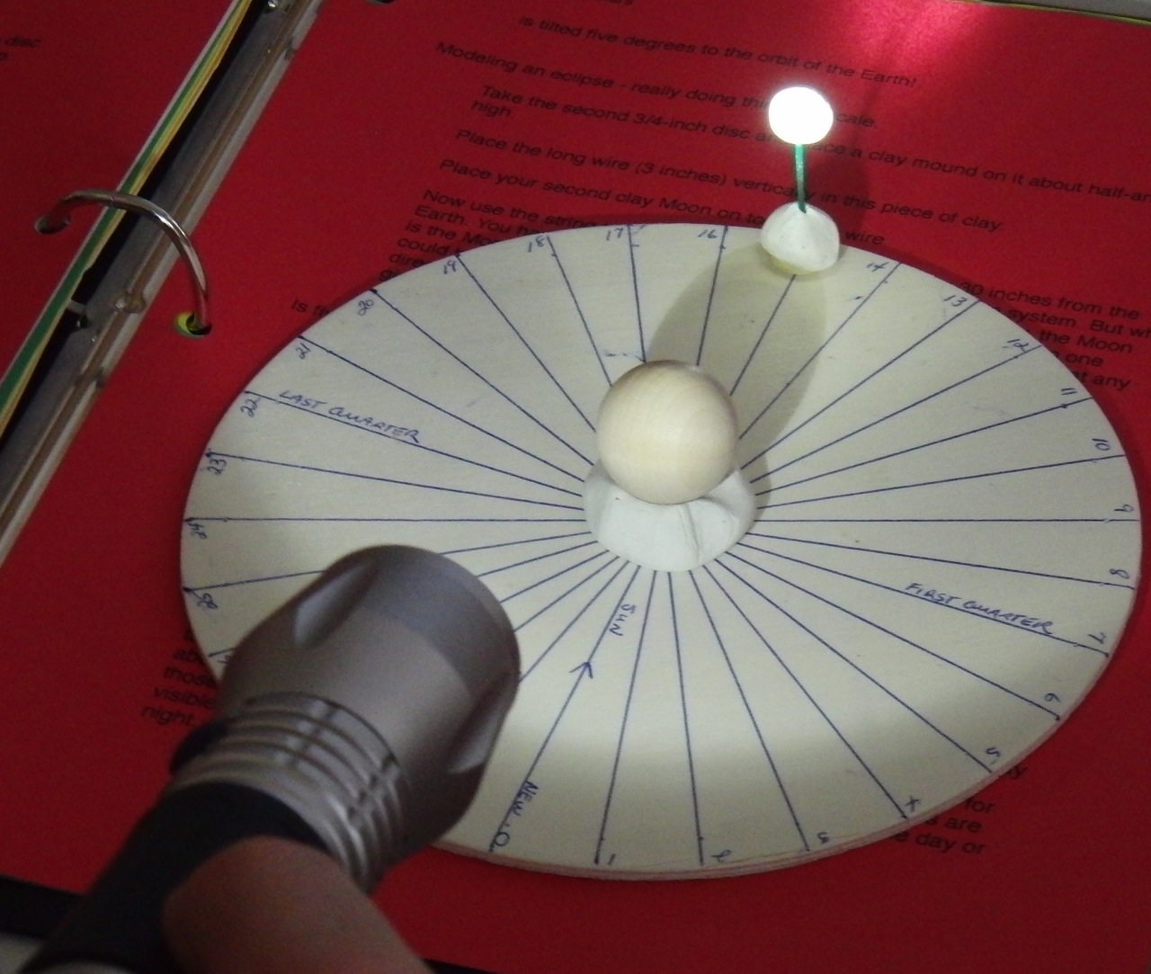
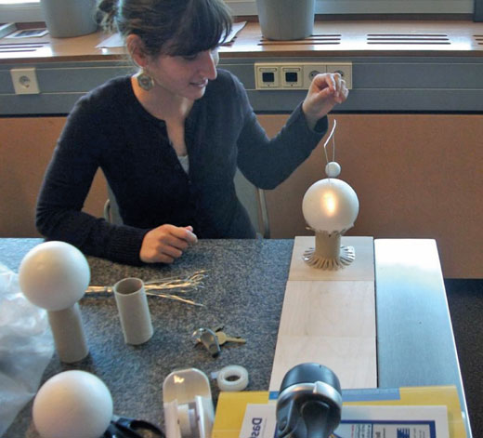

Slide 11
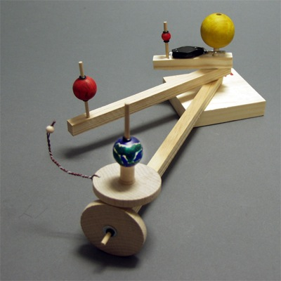
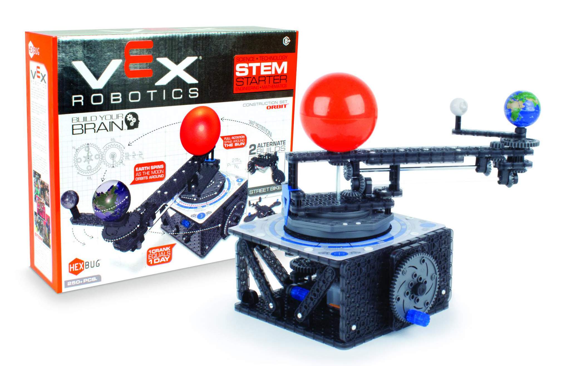

Slide 12
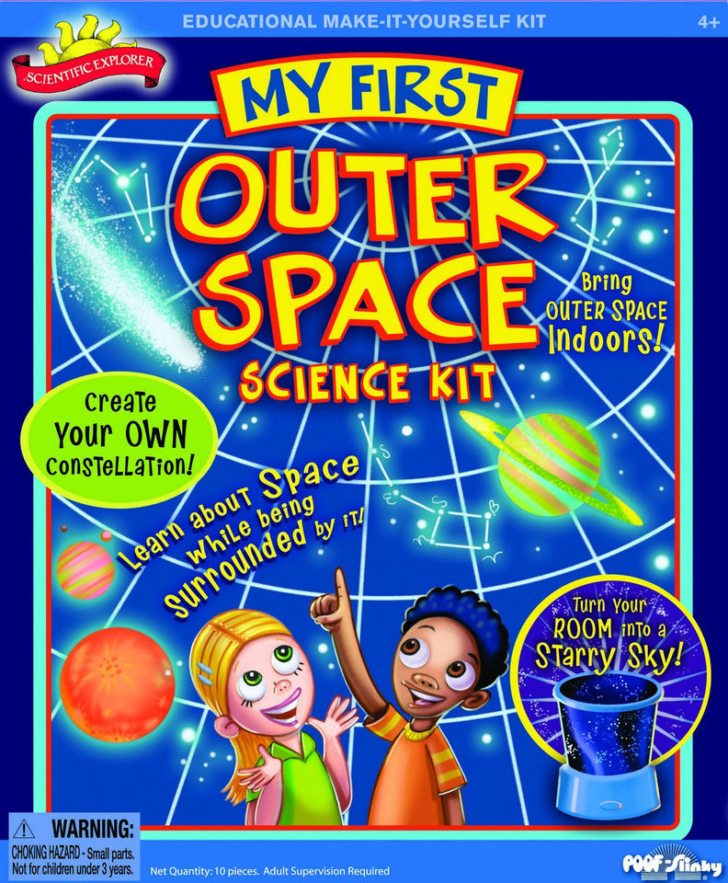
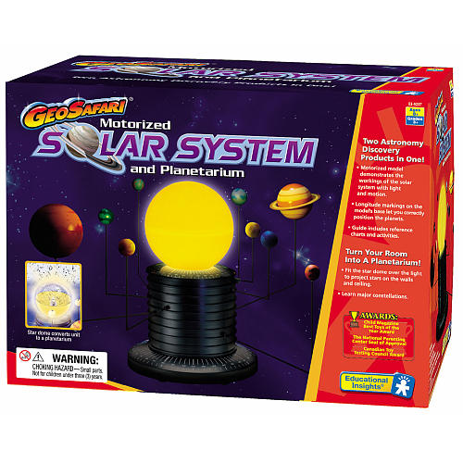

Slide 13
Grading: Scientific Insert
Scientific information supplements the model well
Scientific information is complete, accurate and written in an engaging manner
All material is written in the student’s own words
Graphics are colorful, accurate and correspond well to the scientific concept
Reading level is appropriate for the age of the consumer
Insert is well edited and free of grammatical, punctuation and spelling errors

Slide 14
Grading: directions
Directions are sequential and easy to follow
Directions are written at the level of the consumer
Diagram is included that shows all parts of the kit
Well-labeled diagram of completed model is included
Directions are well edited and free of grammatical, punctuation and spelling errors

Slide 15
Grading: Box design and ad
Design is colorful and neatly drawn
Design attracts the consumer of the appropriate age level
Drawings or diagrams are accurate regarding the kit components
Age level of consumer is clearly identified
Marketing ad (appropriate for a magazine or store advertisement) is simple but engaging, identifies age level of consumer, and is clear about kit contents

Slide 16
Grading: Model
Model can be easily constructed by following the directions
Model corresponds accurately to the scientific concept
Model is appropriate for the age level specified
Model stays together and is not easily broken

