Slide 1
Analysis for Optics Lab
Choose 6 hypothesis/data sections and analyze the hypothesis and the data
Briefly summarize the experimental setup
Summarize the data and explain WHY the observed phenomenon occurred
Discuss whether the results proved or disproved your hypothesis

Slide 2
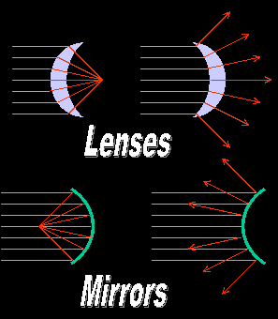
Differences between mirrors and lenses
Light reflects from a mirror
Light goes through and is refracted by a lens

Slide 3
Law of reflection

Slide 4
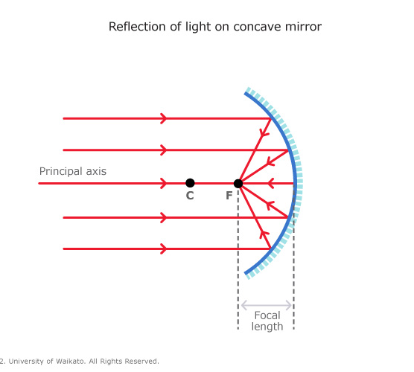
Concave Mirror
Concave mirror converges light to a focal point

Slide 5
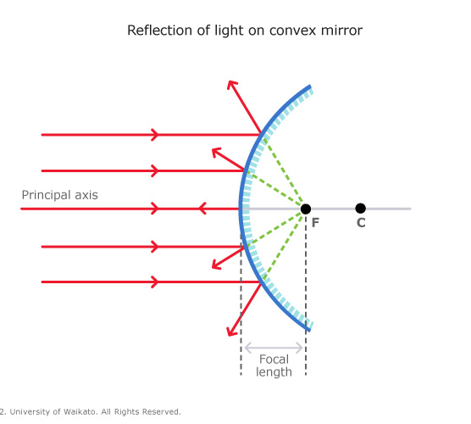
Convex mirror
Convex mirror diverges light

Slide 6
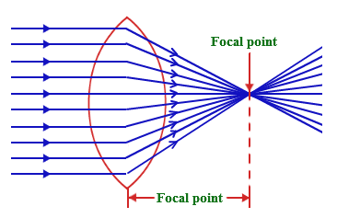
Convex Lens
Thicker in the middle than at the edges
Light rays approaching the lens parallel to the optical axis are refracted toward the center of the lens
Amount of refraction depends on the change in the speed of light as it passes through a material
Thick lenses with highly curved surfaces bend light more than thin ones with less curved surfaces

Slide 8
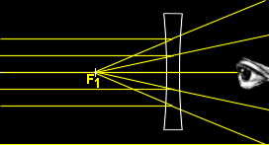
Concave Lens
Thinner in the middle and thicker in the edges
Light passing through a concave lens bends toward the edges
The rays diverge

Slide 9
When a light beam goes from air to glass or plastic at an angle, it is bent toward the normal
The beam in the first medium is called the incident ray, and the beam in the second medium is called the refracted ray.
How much the light bends is based on the angle of incidence and the properties of the medium (glass has a higher index of refraction than water)

Slide 10
